Slide 1
Forecast
Traffic Volume (GBytes) Nationwide
(Actual & Forecast)

Slide 2
12 steps forecast

Slide 3
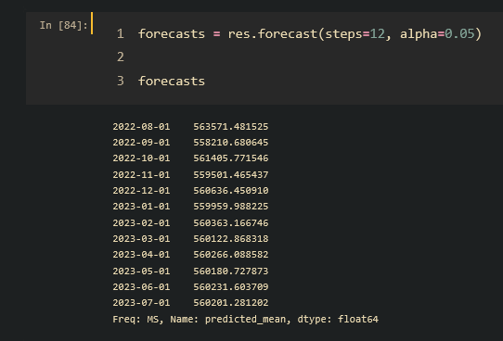
Prediction (12 steps)

Slide 4
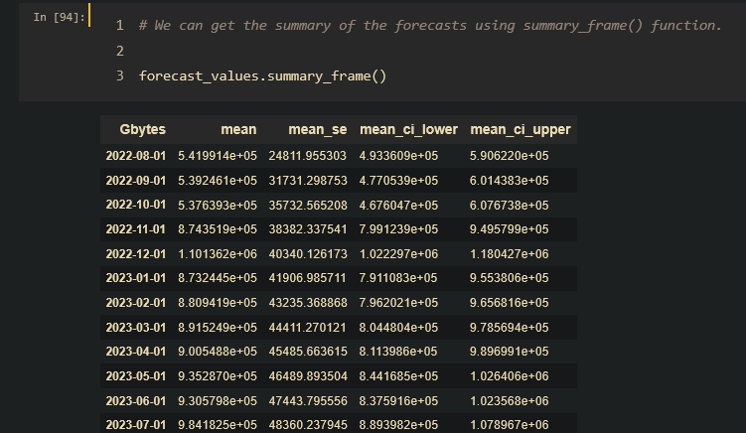
Summary frame

Slide 5
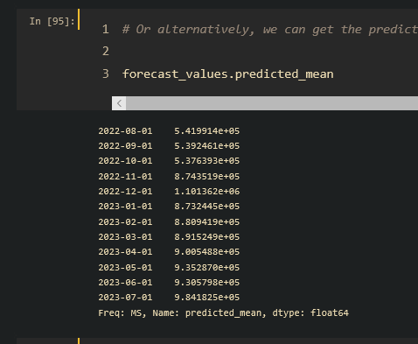
Predicted mean

Slide 6
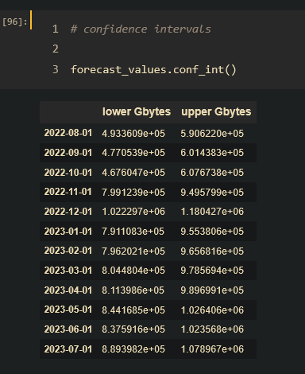
Confidence intervals

Slide 7
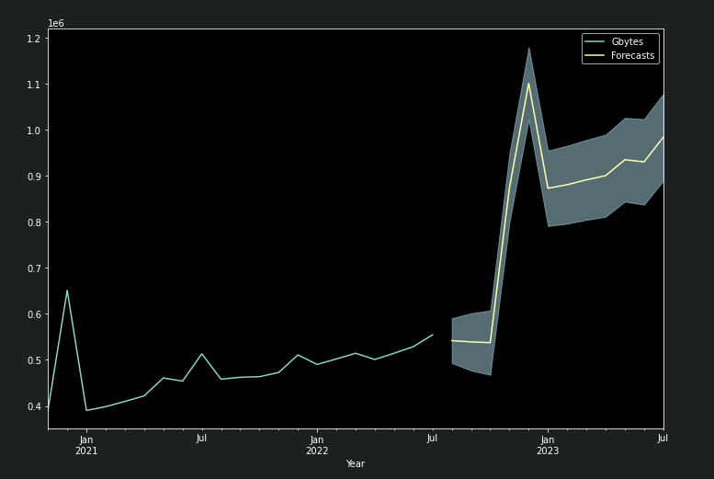
Plotted Graph
Actual & Forecast 12 Steps

Slide 8
50 steps forecast

Slide 9
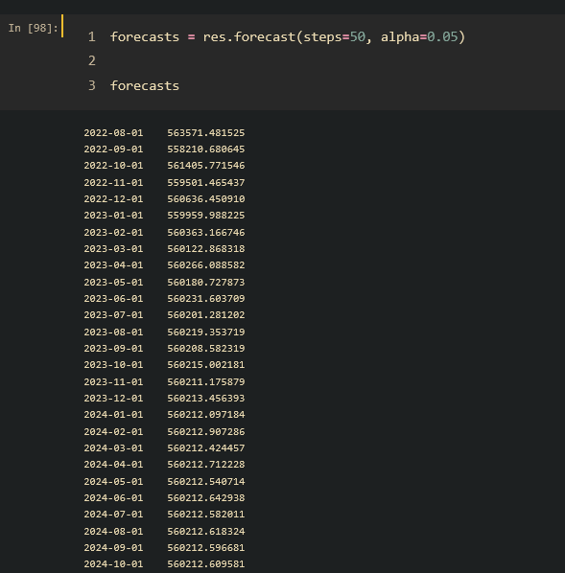
Prediction (50 steps)

Slide 10
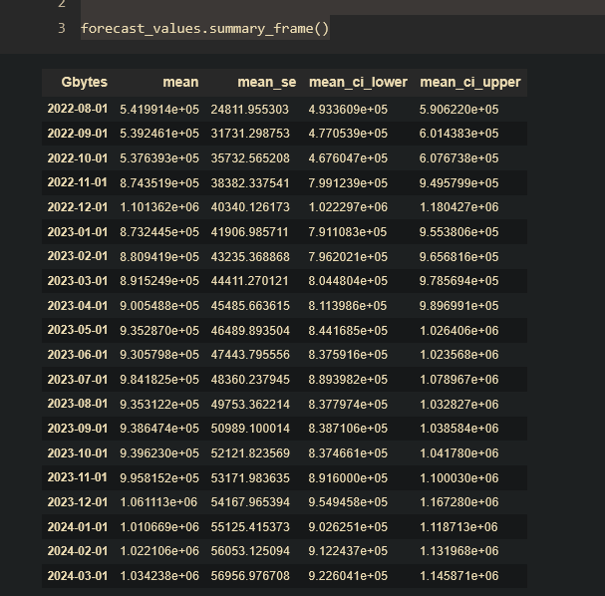
Summary frame

Slide 11
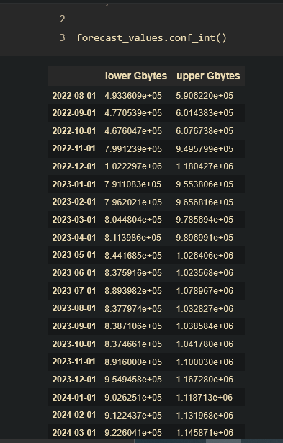
Confidence intervals

Slide 12
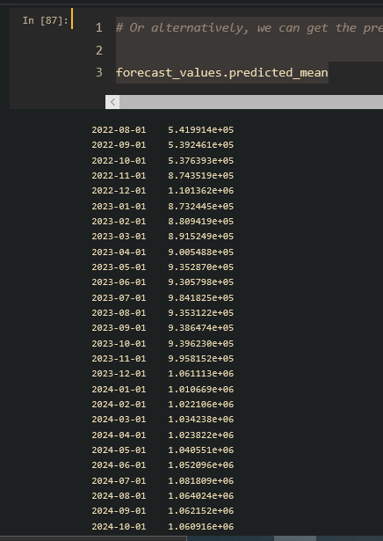
Predicted mean

Slide 13
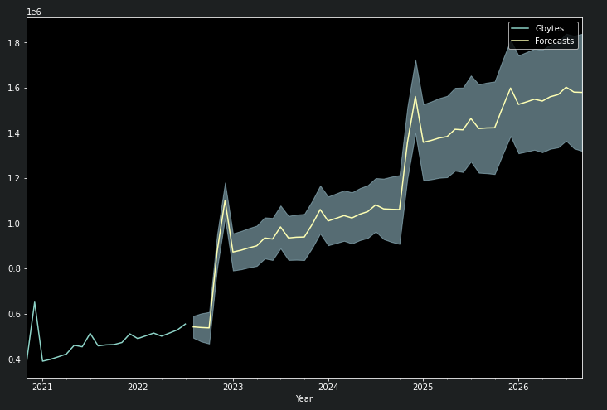
Plotted Graph
Actual & Forecast 50 Steps

